Slide 1
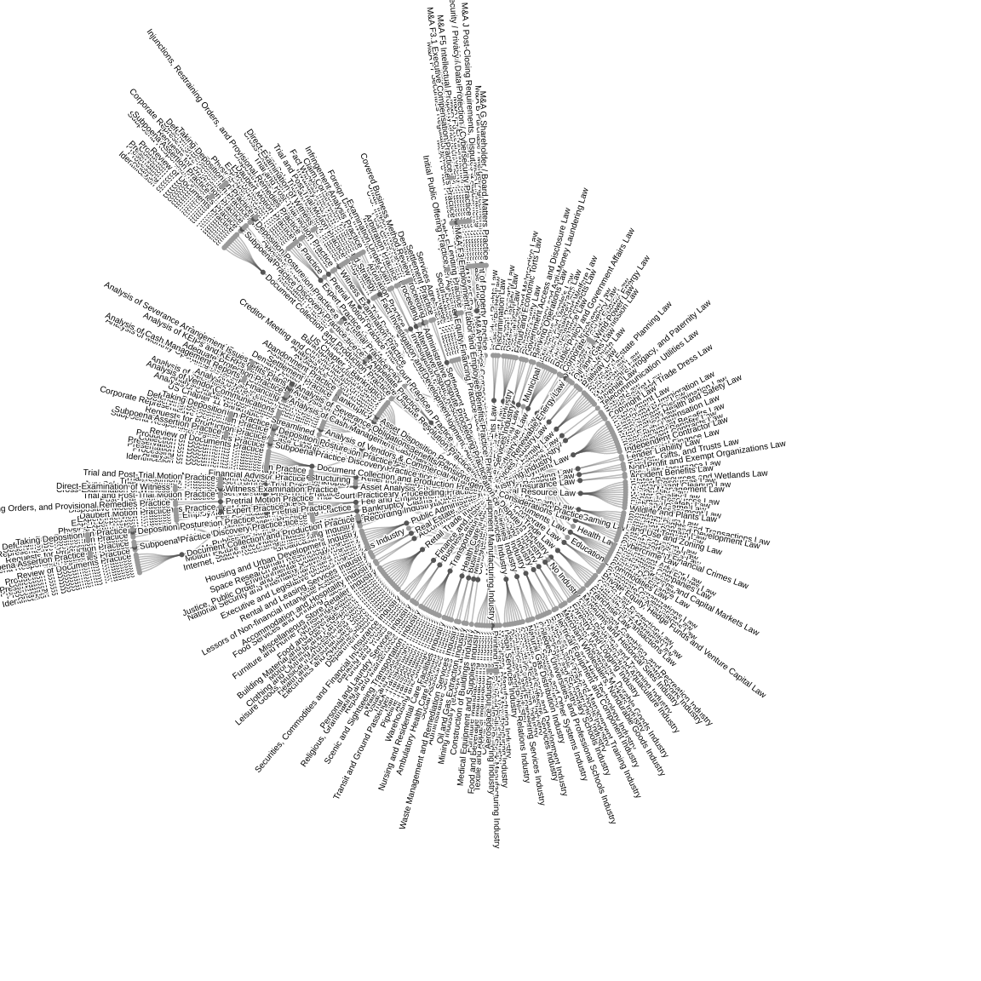
SALI – Area of Law, Service and Industry

Slide 2
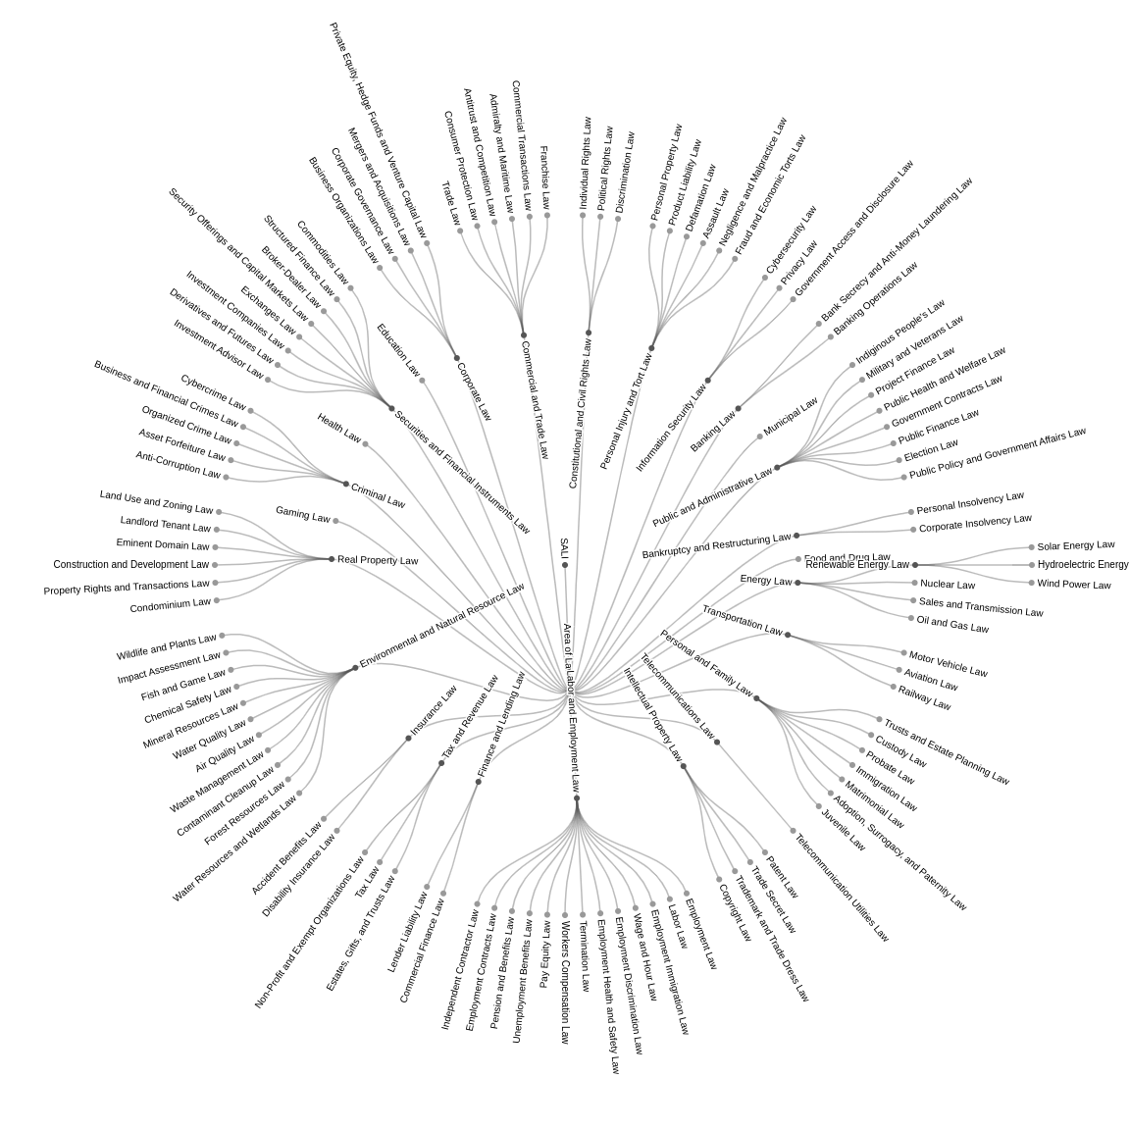
SALI - Area of Law

Slide 3
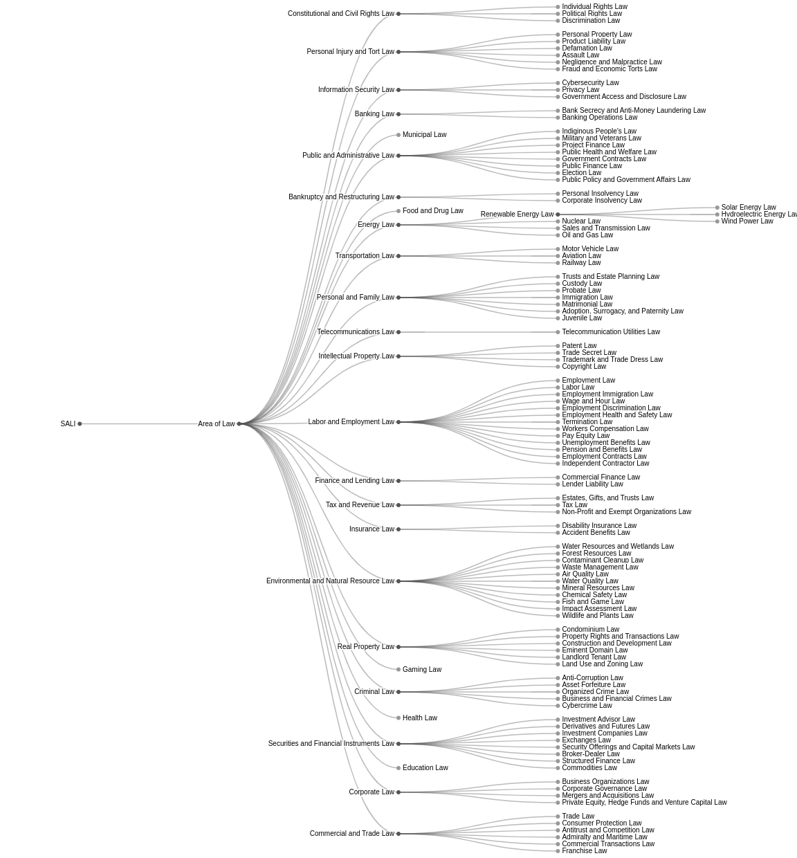
SALI - Area of Law

Slide 4
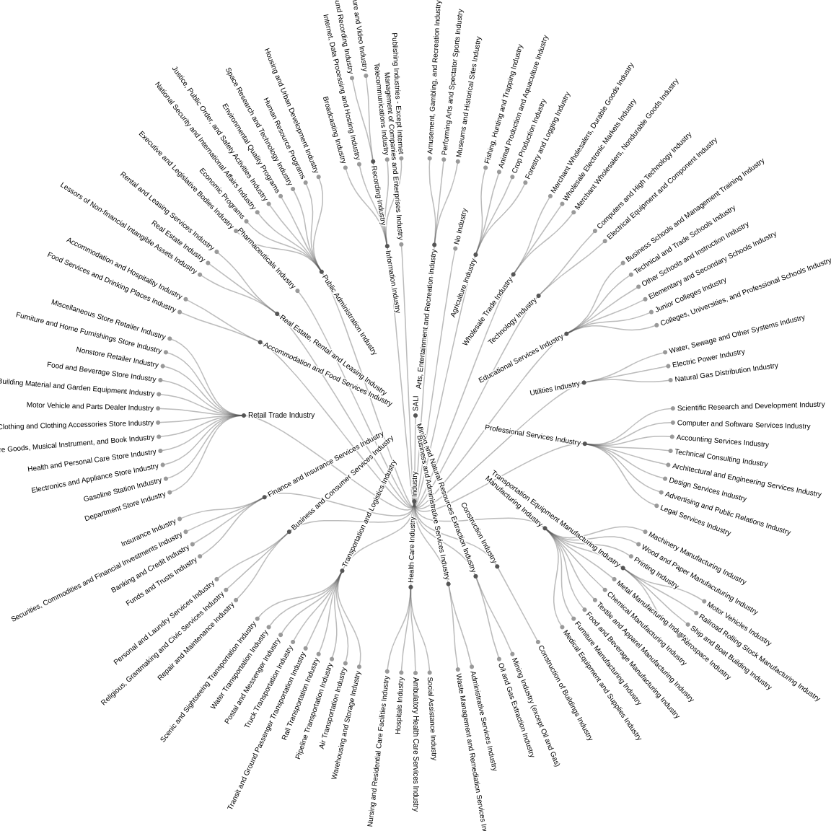
SALI - Industry

Slide 5
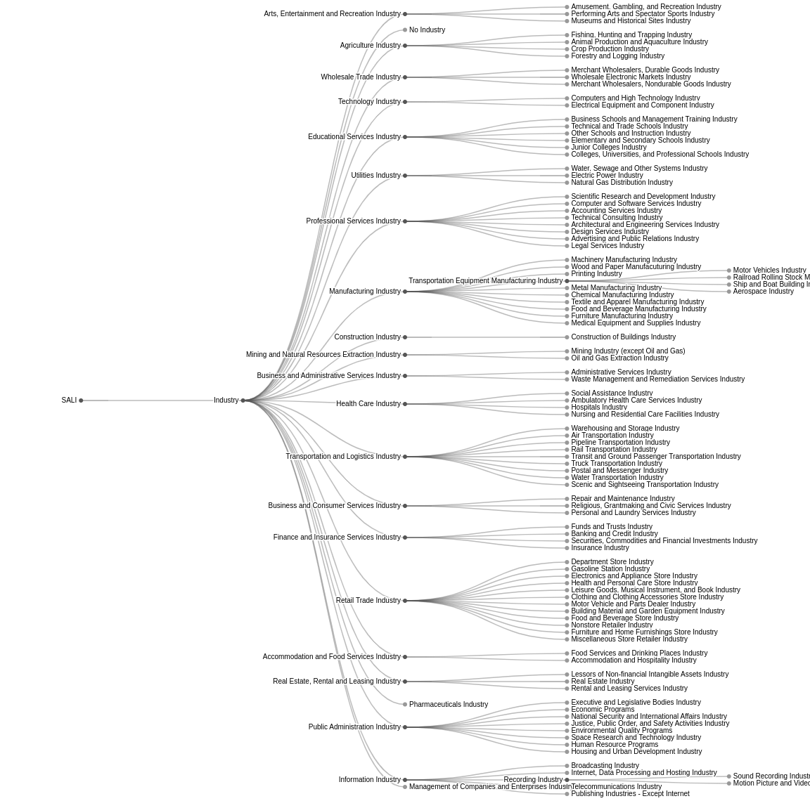
SALI - Industry

Slide 6
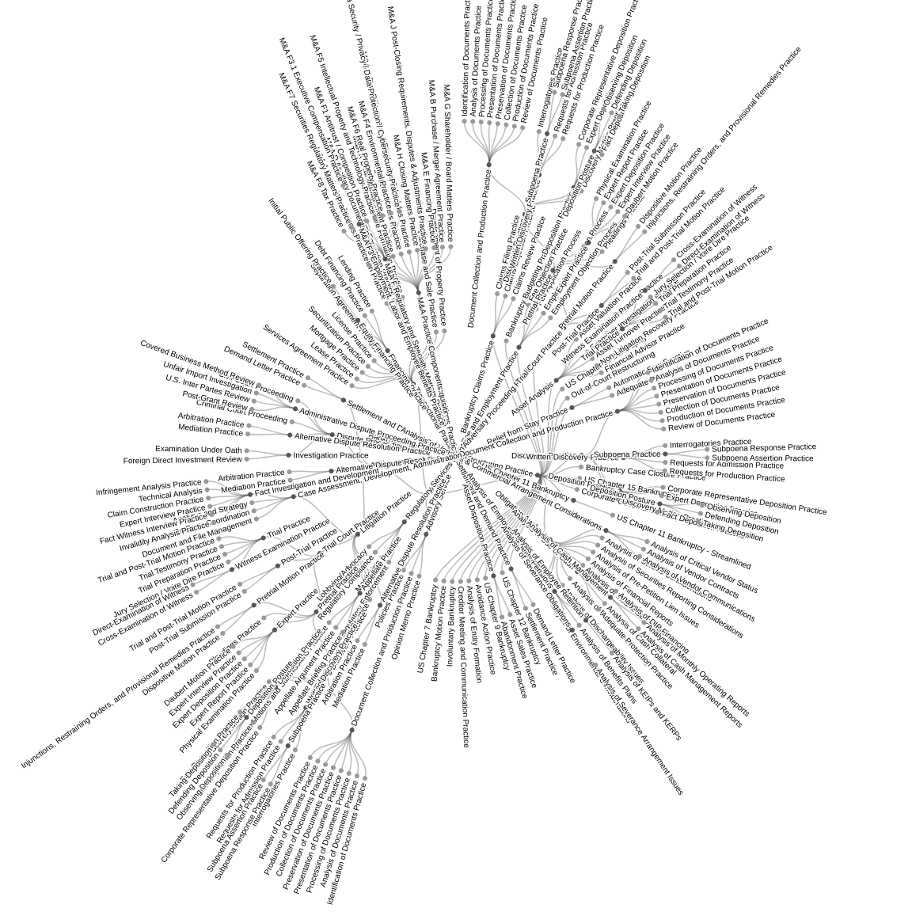
SALI - Service

Slide 7
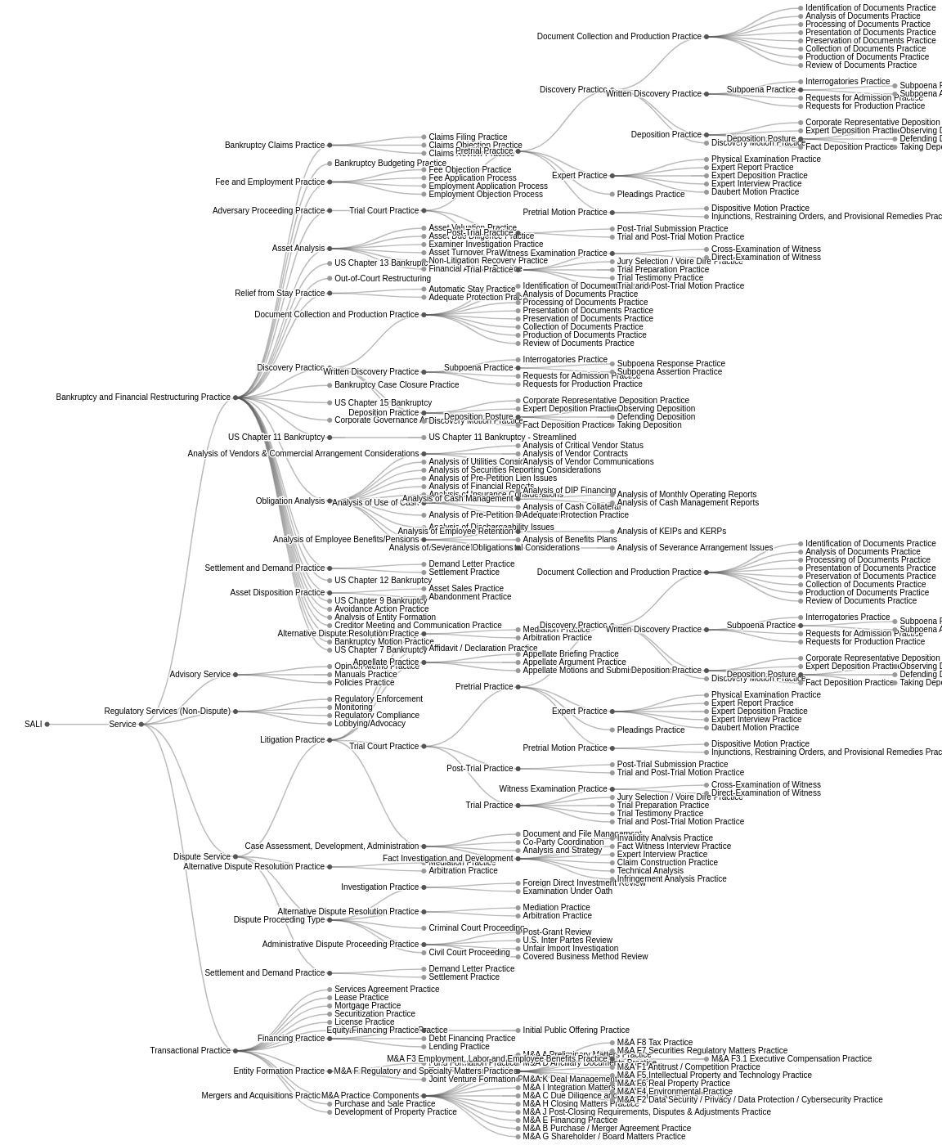
SALI - Service

Slide 8
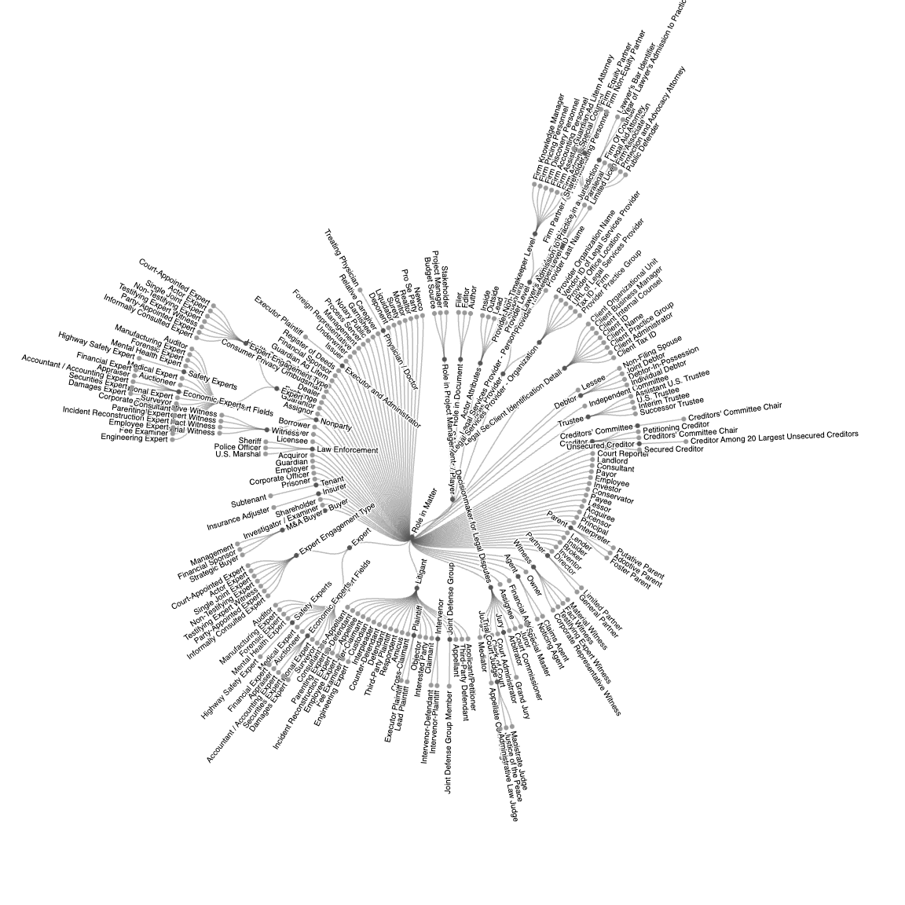
SALI - Actor

Slide 9
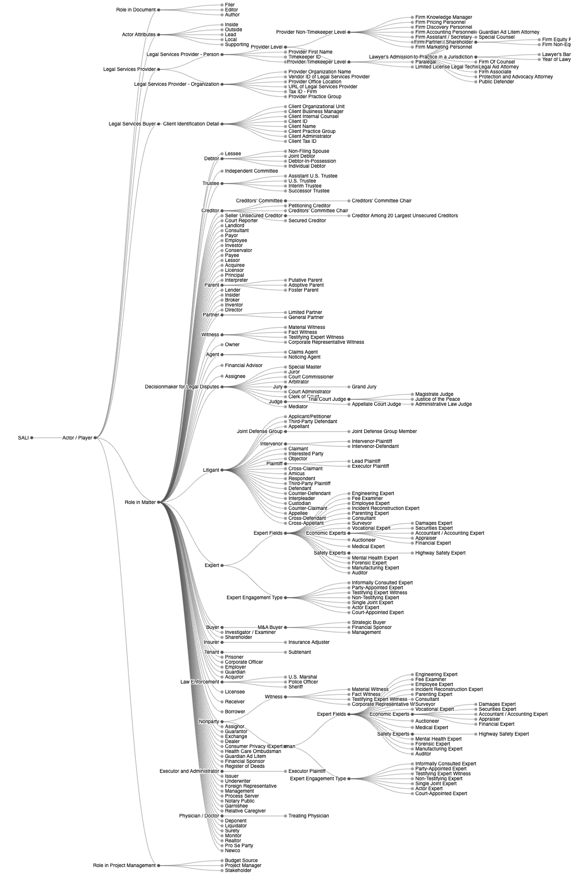
SALI - Actor

Slide 10
SALI Taxonomy Includes the Following (and a few more)
Actor / Player
Area of Law
Asset Type
Forums and Venus
Government Body
Industry
Legal Authorities
Legal Entity
Location
Service

Slide 11

SALI – Industry

Slide 12
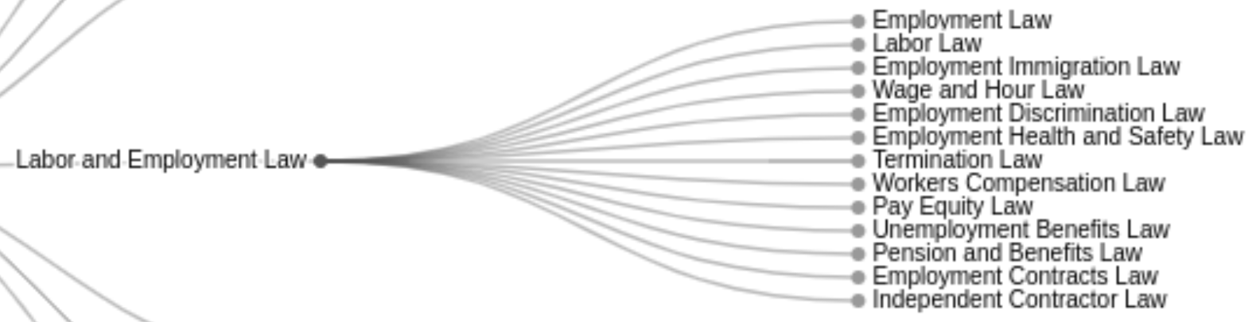
SALI – Area of Law

Slide 13
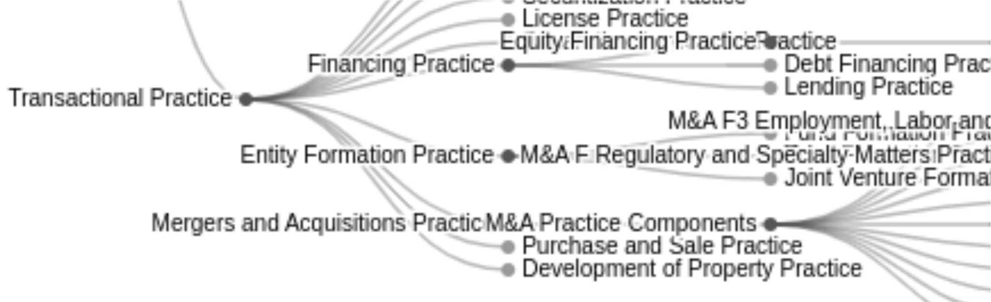
SALI – Service (Practices)

Slide 14
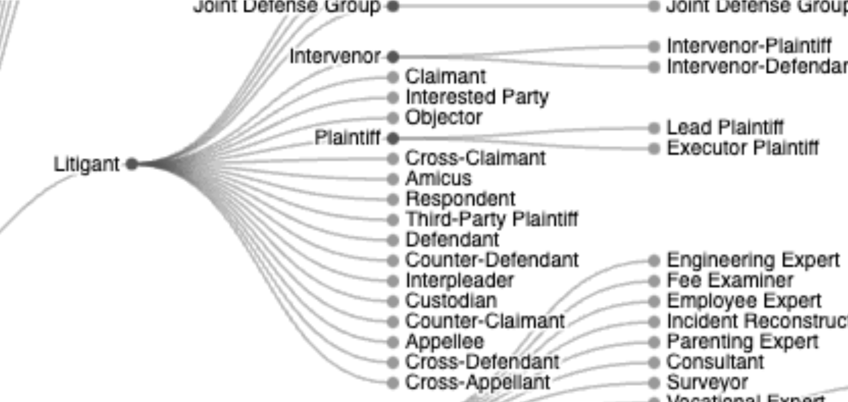
SALI – Matter Role (Inside the Actor / Player Grouping)

